Slide 1
Support Protocols and Technologies

Slide 2
Introduction
Four key support technology
Address binding
Error reporting
Bootstraping
Address translation

Slide 3
Address Resolution
A crucial step of the forwarding process requires a translation:
forwarding uses IP addresses
a frame MUST contain the MAC address of the next hop
IP must be translated into a MAC address
The principle is:
IP addresses are logical addresses
IP address cannot uniquely identify a computer
needs equivalent MAC address
Address resolution
When an IP address obtains MAC address
Address resolution is local to a network

Slide 4
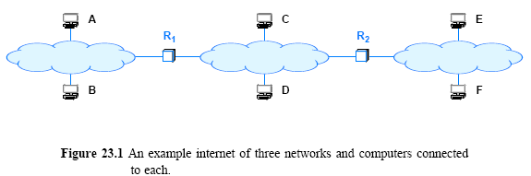
Address resolution cont’
When two computers communicate
Both are local: can resolve address
a computer on a remote network: needs address resolution technique
Address resolution is always restricted to a single network.

Slide 5
The Address Resolution Protocol (ARP)
Consider Figure 23.2
Suppose B needs to resolve the IP address of C
B broadcasts a request that says:
“I'm looking for the MAC address of a computer that has IP address C”
The broadcast only travels across one network
An ARP request message reaches all computers on a network
When C receives a copy of the request along other hosts
Only C sends a directed reply back to B that says:
“I'm the computer with IP address C, and my MAC address is M”

Slide 6
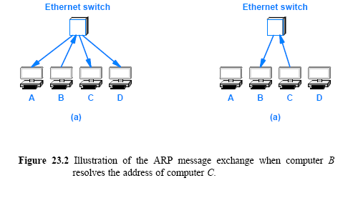

Slide 7
ARP Message Format
The standard describes a general form for ARP messages
Choosing a fixed size for a hardware address is not suitable
New network technologies might be using different size
A fixed-size field at the beginning of an ARP message specifies the size of the hardware addresses
For example, when ARP is used with an Ethernet
the hardware address length is set to 6 octets

Slide 8
ARP Message Format cont’
To increase the generality of ARP
address length field
ARP protocol can be used to bind an arbitrary high-level address to an arbitrary hardware address
In practice, the generality of ARP is seldom used

Slide 9
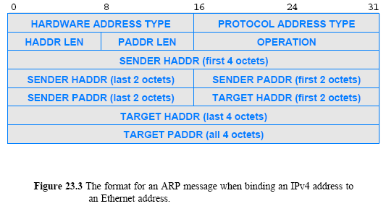

Slide 10
ARP Message Format cont’
HARDWARE ADDRESS TYPE
16-bit field that specifies the type of hardware address being used
the value is 1 for Ethernet
PROTOCOL ADDRESS TYPE
16-bit field that specifies the type of protocol address being used
the value is 0x0800 for IPv4
HADDR LEN
8-bit integer that specifies the size of a hardware address in bytes
PADDR LEN
8-bit integer that specifies the size of a protocol address in bytes
OPERATION
16-bit field that specifies whether the message
request (the field contains 1) or
response (the field contains 2)

Slide 11
ARP Message Format cont’
SENDER HADDR
HADDR LEN bytes for the sender's hardware address
SENDER PADDR
PADDR LEN bytes for the sender's protocol address
TARGET HADDR
HADDR LEN bytes for the target's hardware address
TARGET PADDR
PADDR LEN bytes for the target's protocol address

Slide 12
ARP Message Format cont’
An ARP message contains fields for two address bindings
one binding to the sender
other to target
When a request is sent
the sender does not know the target's hardware address
In a response
the target binding refers to the initial computer that sent the request
Thus, the target address pair in a response serves no purpose
the inclusion of the target fields has survived from an early version of the protocol

Slide 13
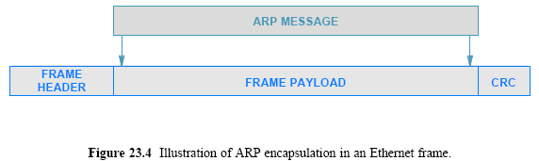
ARP Encapsulation
When it travels across a physical network
an ARP message is encapsulated in a hardware frame
An ARP message is treated as data being transported
the network does not parse the ARP message or interpret fields

Slide 14
ARP Encapsulation cont’
The type field in the frame header specifies that the frame contains an ARP message
Ethernet uses type field 0x806 to denote an ARP message
Sender must assign and receiver must interpret
The same value is used for both ARP requests/ responses
Frame type does not distinguish between types of ARP messages
A receiver must examine the OPERATION field in the message
to determine whether an incoming message is a request or a response

Slide 15
ARP Caching and Message Processing
Three (3) frames traverse the network for each datagram
(an ARP request, ARP response, and the data datagram itself)
Most communications involve a sequence of packets
Use of ARP for every packet is inefficient
To reduce network traffic
ARP maintains a small table of bindings in memory
ARP manages the table as a cache
an entry is replaced when a response arrives
It flushes its contents time to time
ARP starts by searching the cache when it needs to bind an address

Slide 16
ARP Caching and Message Processing cont’
If the binding is present in the cache
ARP uses the binding without transmitting a request
If the binding is not present in the cache
ARP broadcasts a request
waits for a response
updates the cache
and then proceeds to use the binding
The cache is only updated when an ARP message arrives (either a request or a response)

Slide 17
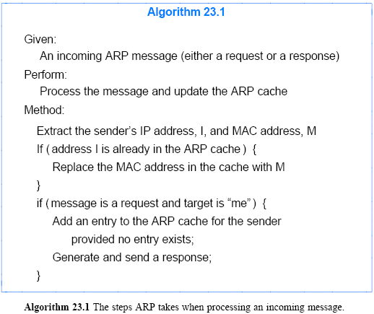
ARP algorithm

Slide 18
The Conceptual Address Boundary
ARP provides an important conceptual boundary between MAC addresses and IP addresses:
ARP hides the details of hardware addressing
It allows higher layers of software to use IP addresses

Slide 19
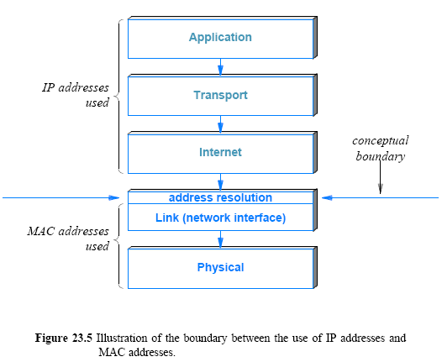

Slide 20
Internet Control Message Protocol (ICMP)
IP defines a best-effort communication service
datagrams can be lost, duplicated, delayed, or delivered out of order
Best-effort service weak on error detection but IP attempts to avoid errors and to report problems when they occur
One example of error detection in IP:
Header checksum is used to detect transmission errors
A checksum covers the header of IP datagram
The checksum is verified whenever a datagram is received
The IP header contains a TIME TO LIVE field
i.e. circular path

Slide 21
Internet Control Message Protocol (ICMP) cont’
When a checksum error is occurred:
The receiver cannot trust any fields in the datagram header
The receiver cannot send an error message back to the sender
Thus, the receiver has no option but to discard the damaged datagram
IP includes a companion protocol, ICMP
It is used to report errors back to the original source
IP and ICMP are co-dependent
IP depends on ICMP to report errors
ICMP uses IP to carry error messages
Many ICMP messages have been defined
Figure 23.6 lists key ICMP messages and their purpose

Slide 22
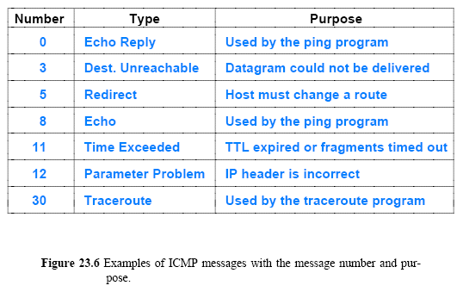

Slide 23
Internet Control Message Protocol (ICMP) cont’
ICMP contains two message types:
messages used to report errors
messages used to obtain information
For example
Time Exceeded and Destination Unreachable are for reporting errors
A datagram times out if
either the TTL count in the header expires or
fragments of the datagram do not arrive before the timer expires
Echo Request and Echo Reply do not correspond to an error
used by the ping
When a host receives an echo request message
ICMP software on a host or router sends an echo reply that carries the same data as the request

Slide 24
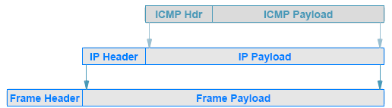
ICMP Message Format and Encapsulation
ICMP uses IP to transport each error message:
when a router has an ICMP message to send
it creates an IP datagram and encapsulates the ICMP message in it
the ICMP message is placed in the payload area of the IP datagram
the datagram is then forwarded as usual

Slide 25
ICMP Message Format and Encapsulation cont’
ICMP messages do not have special priority
They are forwarded like any other datagram, with one minor exception
If an ICMP error message causes an error
no error message is sent – no error messages for error messages

Slide 26
Protocol Software, Parameters, and Configuration
the protocol software is initialized when powered on
For a router, the configuration manager must specify initial values for items such as
the IP address for each network connection
the protocol software to run
initial values for a forwarding table
the configuration is saved, and a router loads the values during startup
Host configuration uses bootstrapping
A protocol was invented to allow a host to obtain multiple parameters with a single request, known as the Bootstrap Protocol (BOOTP)
Currently, DHCP is used to take care of most configuration needed

Slide 27
Dynamic Host Configuration Protocol (DHCP)
An early mechanism known as the Reverse Address Resolution Protocol (RARP) allowed a computer to obtain an IP address from a server
ICMP has Address Mask Request and Router Discovery messages -> to obtain address mask and the address of router
Each of the early mechanisms was used independently
DHCP allows a computer to join a new network and obtain an IP address automatically
The concept has been termed plug-and-play networking

Slide 28
Dynamic Host Configuration Protocol (DHCP) cont’
When a computer boots
the client computer broadcasts a DHCP Request
the server sends a DHCP Reply
offering an address to the client
DHCP server can be configured to supply two types of addresses:
permanently assigned addresses as provided by BOOTP
a pool of dynamic addresses to be allocated on demand
Typically:
A permanent address is assigned to a server
A dynamic address is assigned to an arbitrary host

Slide 29
Dynamic Host Configuration Protocol (DHCP) cont’
DHCP issues a lease on the address for a finite period
When the lease expires
the server places the address to the pool of available addresses
this allows the address to be assigned to another computer
When a lease expires:
A host can relinquish the address
Renegotiate with DHCP to extend the lease
Normally, DHCP approves each lease extension
A computer continues to operate without any interruption
It is possible to deny lease extension for administrative or technical reasons – client must stop using the address
DHCP grants absolute control of leasing to a server

Slide 30
DHCP Protocol Operation and Optimizations
Recovery from loss or duplication
DHCP is designed to insure that missing or duplicate packets do not result in misconfiguration
If no response is received
a host retransmits its request
If a duplicate response arrives
a host ignores the extra copy
Caching of a server address
once a DHCP server is found
the host caches the server's address
Avoidance of synchronized flooding, e.g., power failure
When multiple hosts request address simultaneously -> have the clients delay a random time

Slide 31
DHCP Message Format
DHCP adopted a slightly modified version of the BOOTP message format
Figure 23.8 illustrates the DHCP message format
OP specifies whether the message is a Request or a Response
HTYPE and HLEN fields specify the network hardware type and the length of a hardware address
FLAGS specifies whether it can receive broadcast or directed replies
HOPS specifies how many servers forwarded the request
TRANSACTION IDENTIFIER provides a value that a client can use to determine if an incoming response matches its request
SECONDS ELAPSED specifies how many seconds have elapsed since the host began to boot

Slide 32
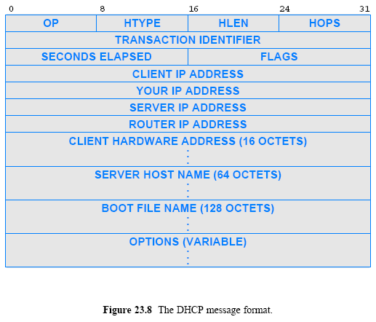

Slide 33
DHCP Message Format
Later fields in the message are used in a response to carry information back to the host that sent a request
if a host does not know its IP address, the server uses field YOUR IP ADDRESS to supply the value
server uses fields SERVER IP ADDRESS and SERVER HOST NAME to give the host information about the location of a server
ROUTER IP ADDRESS contains the IP address of a default router
DHCP allows a computer to negotiate to find a boot image
To do so, the host fills in field BOOT FILE NAME with a request
The DHCP server does not send an image

Slide 34
Indirect DHCP Server Access Through a Relay
DHCP broadcasts on the local network to find a server
DHCP does not require each individual network to have a server
Instead, a DHCP relay agent forwards requests and responses between a client and the server
At least one relay agent must be present on each network
and the relay agent must be configured with the address of the appropriate DHCP server
When the server responds
the relay agent forwards the response to the client
Purpose of having one DHCP server with agent
Administrative
Routers provides relay agent

Slide 35
Network Address Translation (NAT)
IP addresses getting scare
subnet and classless addressing (CIDR) were introduced
Another mechanism was invented for sharing a single, globally valid IP address, known as Network Address Translation (NAT)
NAT provides transparent communication
a host in the Internet always appears to receive communication from a single computer rather than from one of many computers at the site
NAT runs as an in-line service
It must be placed on the connection between the Internet and a site
Most implementations embed NAT in another device
such as a Wi-Fi wireless access point or an Internet router

Slide 36
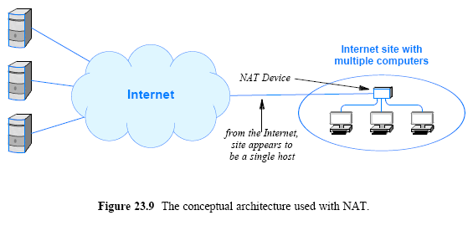

Slide 37
NAT Operation and Private Addresses
The goal of NAT is to provide an illusion
When viewed from the Internet
the site appears to consist of a single host computer that has been assigned a valid IP address
all datagrams sent from the site appear to originate from one host
and all datagrams sent to the site appear to be sent to one host
When viewed from a host in the site
the Internet appears to accept and route private addresses
A single IP address cannot be assigned to multiple computers

Slide 38
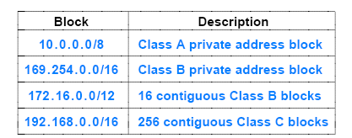
NAT Operation and Private Addresses
NAT solves the problem by using two (2) types of addresses
The NAT device itself is assigned a single globally-valid IP address
Each computer at the site is assigned a unique private address
The following addresses are designated as private by IETF

Slide 39
NAT Operation and Private Addresses
Private addressing is valid within a site
Must have valid IP address before a datagram allowed onto the Internet
NAT must translate the private IP into a globally valid IP address
The other way around should be done, too
Basic function of NAT is a two-way translation, such as
the source address translation
as a datagram passes from the site to the Internet and
the destination address translation
as a datagram passes from the Internet to the site

Slide 40
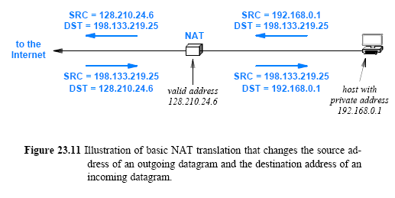

Slide 41
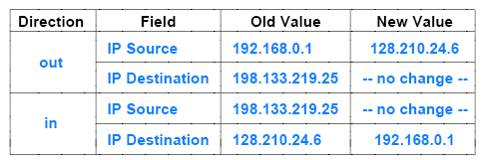
NAT Operation and Private Addresses
Most implementations of NAT use a translation table
to store the information needed to rewrite addresses
Figure 23.12 (below) shows a translation table that corresponds to the address mapping in Figure 23.11

Slide 42
Transport-Layer NAT (NAPT)
NAT handles situations in which each host at a site communicates with a unique server in the Internet
If two hosts at the site attempt to communicate with remote server X,
the translation table will contain multiple entries for X
and NAT will not be able to route incoming datagrams
When two or more applications running on a given host at a site attempt simultaneous communication with different destinations on the Internet, basic NAT will fail

Slide 43
Transport-Layer NAT (NAPT)
A variation of NAT, called Network Address and Port Translation (NAPT) avoids such problems:
It allows a site to have arbitrary numbers of applications running on arbitrary hosts
all communicating simultaneously with arbitrary destinations throughout the Internet
most networking professionals assume the term NAT means NAPT
Applications use protocol port numbers to distinguish among services
In addition to a table of source and destination addresses
NAPT uses port numbers to associate each datagram with a TCP or UDP flow

Slide 44
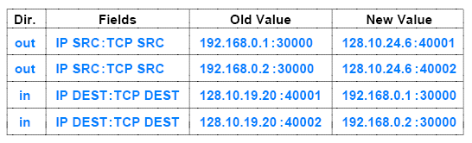
Transport-Layer NAT (NAPT)
Instead of stopping at the IP-layer
NAPT operates on transport-layer headers
NAPT entries contain a 4-tuple of source and destination IP addresses and protocol port numbers
To avoid a conflict
NAPT must choose an alternative TCP source port for the connections
Figure 23.13 (below) shows one possibility (web-server)

Slide 45
NAT and Servers
NAT system builds a translation table automatically
by watching outgoing traffic and establishing a new mapping whenever an application at the site initiates communication
Automatic table construction does not work well for communication initiated from the Internet to the site
For example, if multiple computers at a site each run a web server
the NAT device cannot know which computer should receive an incoming web connection
A variant of NAT called Twice NAT has been created to allow a site to run multiple servers:
Twice NAT arranges for the NAT system to interact with the site's DNS server

Slide 46
NAT Software and Systems for Use at Home
NAT is especially useful at a residence or small business that has a broadband connection
it allows a set of computers to share the connection
A NAT software can make a PC act as a NAT device
dedicated NAT hardware systems are available
Such systems are usually called wireless routers
The terminology is slightly misleading because such routers also provide wired connections for host computers
Figure 23.14 illustrates how such a router is connected

Slide 47
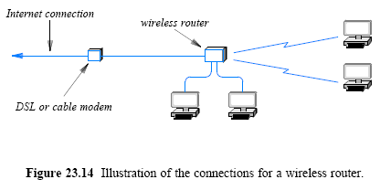
NAT Software and Systems for Use at Home

